Slide 1
Supply Chain Management Dashboard

Slide 2
Dataset Supply chain analytics is a valuable part of data-driven decision-making in various industries such as manufacturing, retail, healthcare, and logistics. It is the process of collecting, analyzing and interpreting data related to the movement of products and services from suppliers to customers. Here is a dataset we collected from a Fashion and Beauty startup. The dataset is based on the supply chain of Makeup products. Below are all the features in the dataset Product Type ● SKU ● Price ● Availability ● Number of products sold ● Revenue generated ● Customer demographics ● Stock levels ● Lead-times ● Order quantities ● Shipping times ● Shipping carriers ● Shipping costs ● Supplier name ● Location ● Lead-time ● Production volumes ● Manufacturing lead time ● Manufacturing costs ● Inspection results ● Defect rates ● Transportation modes ● Routes ● Cost

Slide 3
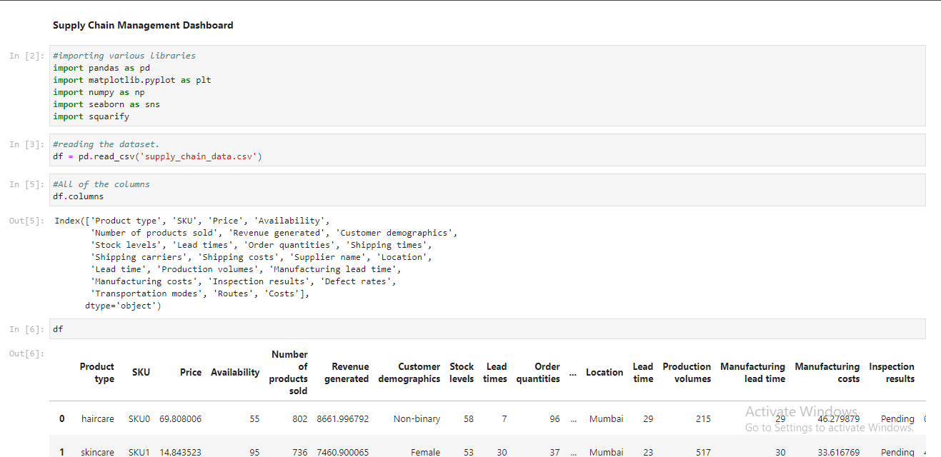
Fashion and Beauty startup: (Supply Chain Management)
The supply chain in a fashion and beauty startup involves the processes of product development, sourcing, manufacturing, logistics, sales, and customer service, all aimed at efficiently delivering high-quality products to consumers.

Slide 4
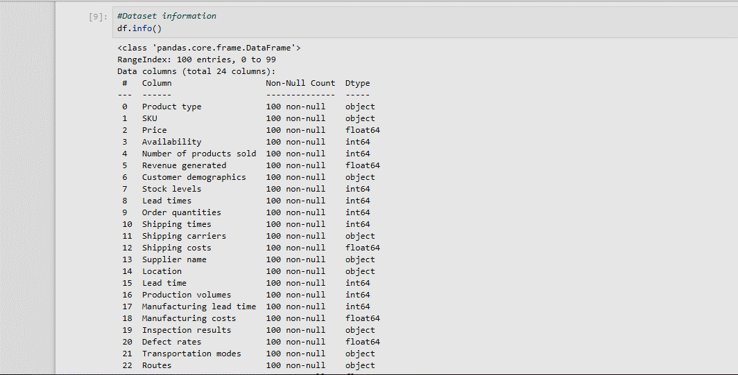
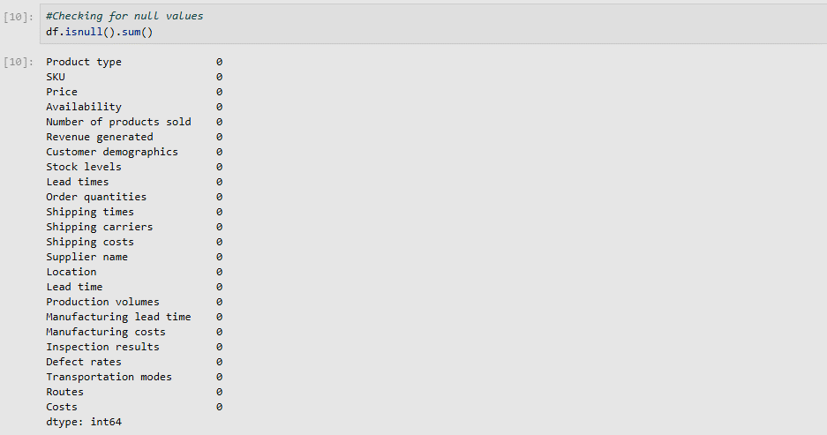
Information of our dataset
Checking Null Values

Slide 5
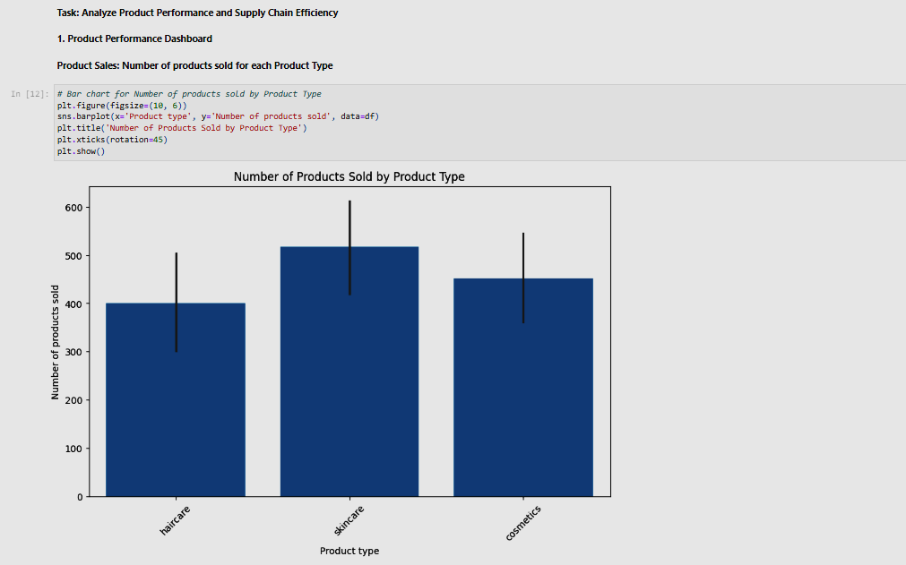
Task 2: Analyze Product Performance
1. Product Performance Dashboard:
Product Sales: Bar chart showing Number of products sold for each Product Type

Slide 6
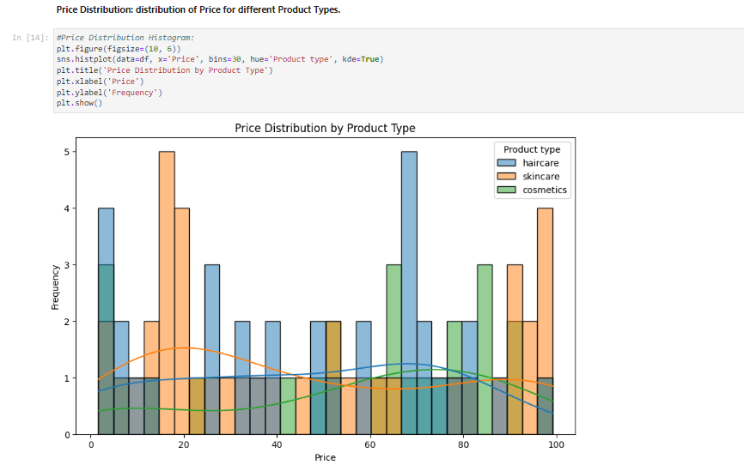
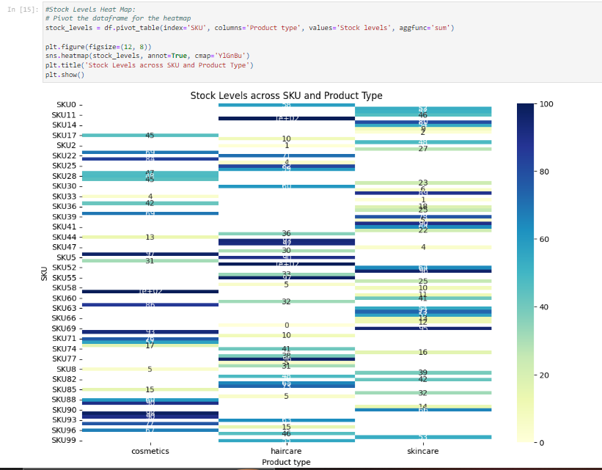
Price Distribution: Distribution of Price for different Product Types.
Stock Levels: Heat map to visualize Stock levels across different SKU and Product Type

Slide 7
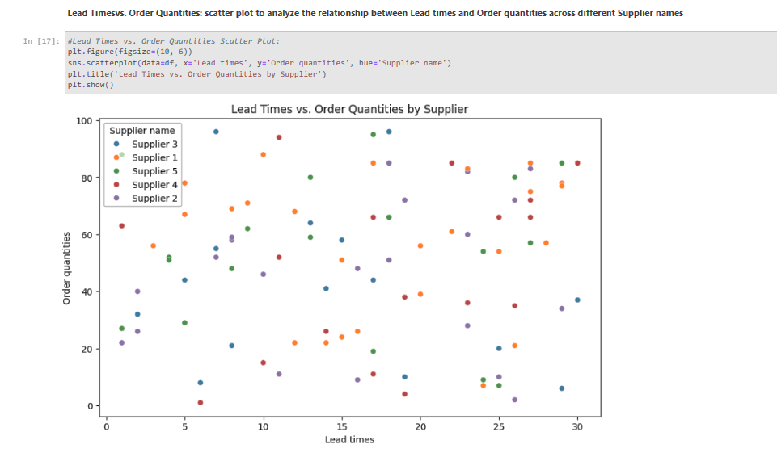
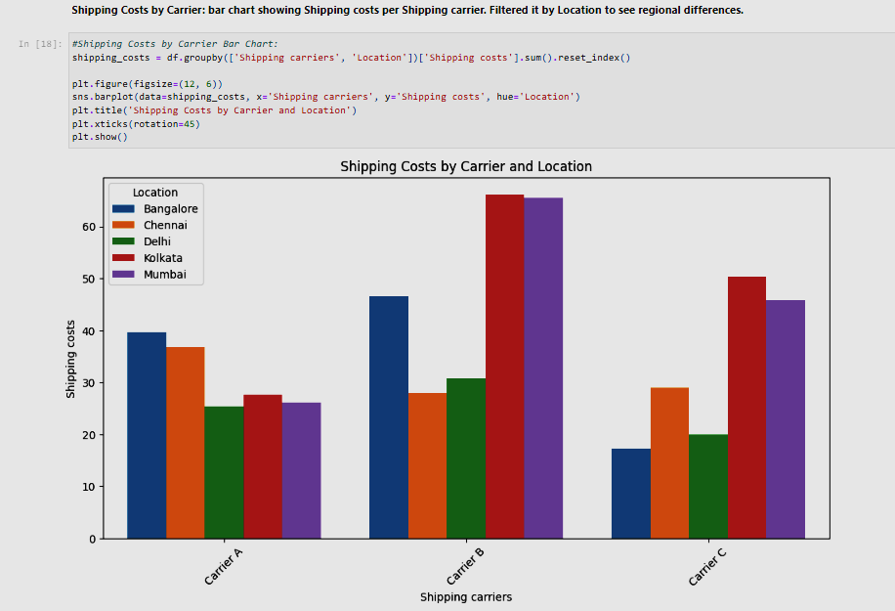
Task 3:Supply Chain Efficiency Dashboard:
Lead Times vs. Order Quantities: Scatter plot to analyze the relationship between Lead times and Order quantities across different Supplier names
Shipping Costs by Carrier: Bar chart showing Shipping costs per Shipping carrier. Filtered it by Location to see regional differences.

Slide 8
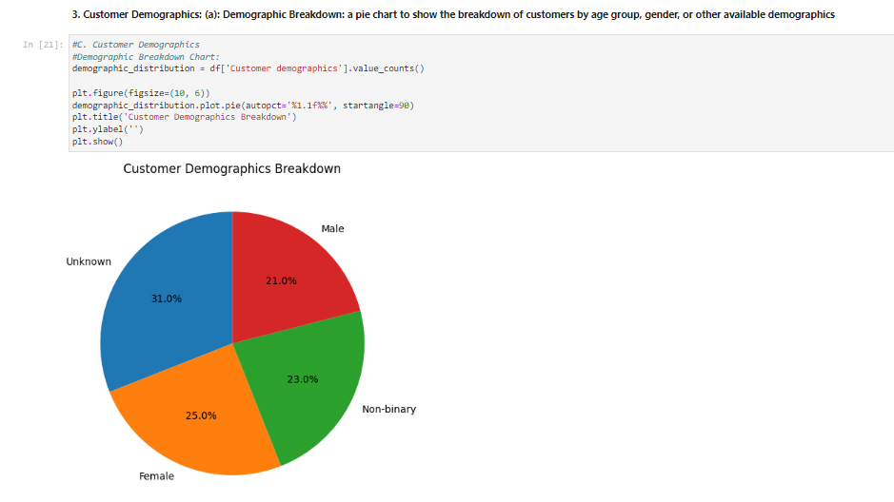
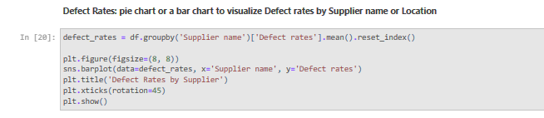
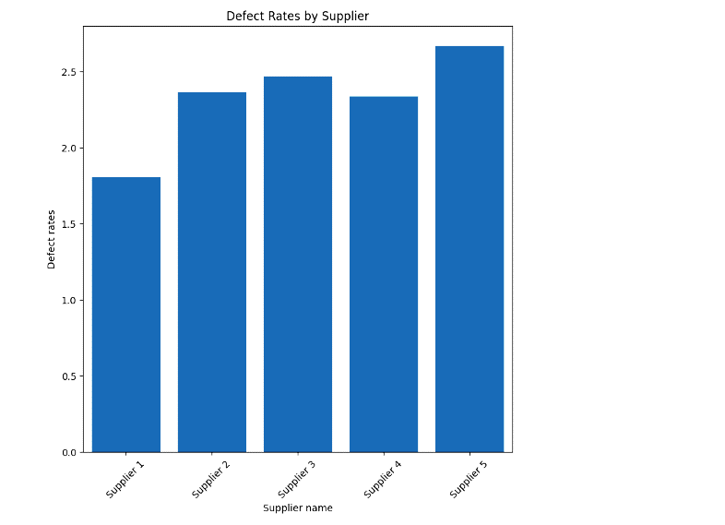
Defect Rates: Bar chart to visualize Defect rates by Supplier name or Location
Task 4. Customer Demographics:
(a): Demographic Breakdown: a pie chart to show the breakdown of customers by age group, gender, or other available demographics

Slide 9
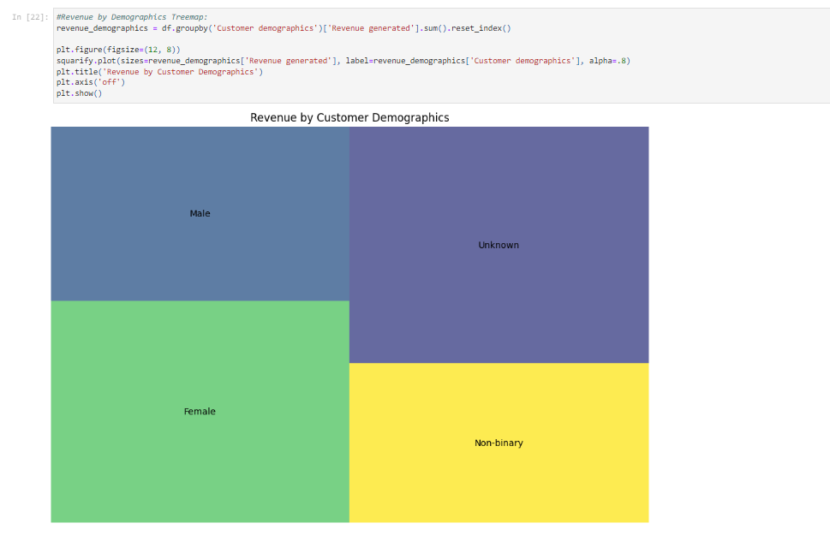
b): Revenue by Demographics: tree map to show Revenue generated segmented by Customer demographics.

Slide 10
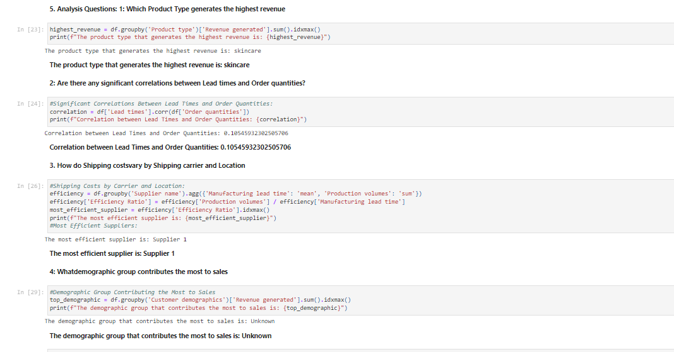
Task 5 : Analysis Questions:

